Slide 1

Rakuten Mobile
April 2025

Slide 2

What we will cover in this version
1
Recap
2
Our Success Stories around data monetization
3
Our curated approach to maximize data monetization
4
Key building blocks of data monetization
5
Our Day 1 team for this engagement

Slide 3

Recap and deep dive into this proposal

Slide 4
Recap and deep-dive into proposal
Rakuten Mobile, with a subscriber base of over 8.3 million, has gathered an enormous amount of data. To capitalize the value trapped in data, the organization is looking for Subject Matter Expertise on Data Monetization.
In the previous version, we provided a preliminary view on data monetization covering the following aspects
  Our Understanding of Rakuten Mobile’s Strategic Priorities
  Our insights into Rakuten Mobile: Key Highlights
  Key use cases for unlocking opportunities
  Our curated Go-To-Market(GTM) approach
  High level approach & methodology
  Comprehensive framework for execution
Rakuten Mobile is further seeking view on Capgemini’s capabilities and assets for identifying opportunities and methodologies to monetize the data and deploy various use cases. Continuing on our previous conversation, we are sharing an overview of our capabilities to build more context around what we can offer to enable monetization of the use cases and foster a partnership that can help reap benefits for many opportunities to come.
This document focuses on the following –
    Data Monetization Operating Model building blocks
    Data Monetization success stories
    Approach and deliverable details

Slide 5
Our Success Stories around data monetization

Slide 6
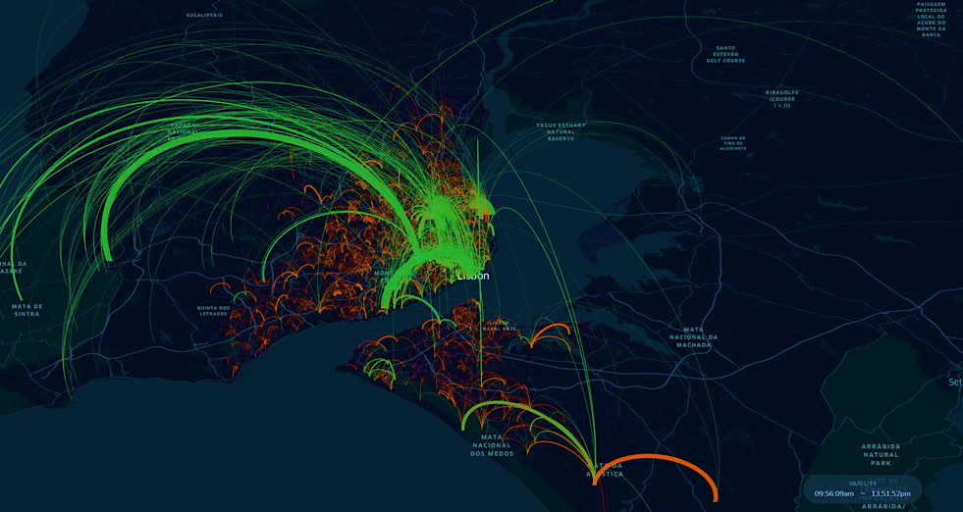
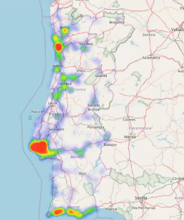
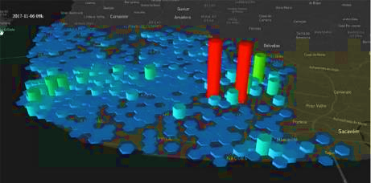
We have designed and implemented B2B data monetization for a Portuguese Telco, delivering curated solutions to meet their business needs
Client Overview
A Portuguese Telecommunications and Media company which provides mobile and fixed telephony, cable television, satellite television and internet services.
Development of an origin destination matrix for geospatial data processing.
Integration of mobile signaling data events (millions of records per day).
Anonymization of data processes.
Correlation with Mobile Sites’ geolocation.
Billions of data entries.
Development of data monetization solutions suite to a wide range of industries like government, transportation, retail, tourism, finance, utilities
Opportunity to expand the company’s offer by providing powerful presence and mobility insights, thus enabling better data-driven decision making and value creation
Innovative portfolio of insights, such as mobility patterns, incoming/outgoing footfall, dwell time, customer segmentation and event analysis
Development and delivery of presence and mobility insights based on mobile network data
Challenges
Value Delivered
Approach

Slide 7









We have delivered complex and high-impact solutions across non-telco industries as well
1
2
3
4
Internal Data marketplace
Monetizing and
sharing data
Monetizing data services
Development of an orchestration platform
  Make data products available across business units
  Create new revenue streams and differentiate from the competition
  Create a privileged relationship with partners while increasing the value generated by data sharing
  Assert a strategic position as a key cross-sector orchestrator
  Non-Profit Regional Health Plan
  Leading French Automobile Manufacturer
  European Aircraft Manufacturer
  Global Retailer
  Capgemini strategized and implemented Data Excellence Platform supported by an industry standard consumption layer for data products related to Cost and Quality of Care, Provider Performance, Population Health and Member Experience
  Capgemini has accompanied one of the leading automobile manufacturer to benchmark existing data sharing patterns (type of data, technology, pricing..), to identify how to build the best data monetization portfolio in the Auto industry
  Capgemini assisted a major retail player in framing its data monetization strategy, in order to offer new paying services to its suppliers
  As a first mover in its market, the firm monetizes access to its data platform as well as to services enabled by the completeness of the aggregated data to aeronautical players

Slide 8
Our curated approach to maximize
data monetization

Slide 9

Our curated approach highlights a scalable and sustainable framework to maximize growth
Discovery & Assess
Strategy & Planning
Execute & Support
ACTIVITIES
Assess Rakuten Mobile’s digital assets and data inventory
Deep dive and segment data based on functionality, quality and usage
Recommend the roadmap for prioritized list of use cases for Data Monetization
Identify the use cases and services with the desired revenue potential
Define the prioritized use cases based on data readiness, technical feasibility, expected ROI
Align with the Data strategy and Data Governance programs to collaborate on common initiatives to achieve the desired data monetization scenarios
Identify the market / potential customers with the desired revenue potential. Define the ethical & legal and privacy guidelines
Perform cost-benefit analysis for identified use cases
Recommend & support implementation
Opportunities’ identification
Product Formulation
Execution Roadmap
DELIVERABLES
List of digital assets and data inventory
List of prioritized Use cases with value proposition
Pricing approaches
Identified list of relevant data use cases with monetization opportunities
Cost-benefit analysis for identified use cases
Prioritized Data Monetization opportunities with roadmap
Critical Tasks
ASSESS Rakuten Mobile’S DIGITAL ASSETS and data inventory
IDENTIFY POTENTIAL USE CASES WITH DESIRED REVENUE POTENTIAL
Deep dive and segment data based on functionality, quality and usage
DEFINE list of prioritized use cases AND PRICING APPROACHES
ALIGN WITH OTHER TRACKS FOR COMMON INITIATIVES
Prioritized Data Monetization opportunities with roadmap

Slide 10
Key building blocks of data monetization
I
External & internal Monetization
II
Data Market Place
III
Data Sharing Mechanism
IV
Target State Data Sharing Capability
V
Data Monetization Reference Architecture
VI
Data Market Place – Sample Snapshots

Slide 11
We have the conviction that effectively leveraging both internal and external data is essential for maximizing value creation
Leverage pricing and revenue assurance strategy to open up the various Data Use cases for Rakuten Mobile’s external partners and monetize data management and value-added services, supported by functionalities adapted to consumers' requirements
EXTERNAL DATA MONETIZATION
Structure Data Use Cases and implement internal Data sharing patterns for Rakuten Mobile’s internal stakeholders to enable multiple use cases like cross market unit analysis / value creation and other analytical opportunities
Data Services
INTERNAL DATA MONETIZATION
Value
Set up the Data foundations to have a portfolio of controlled and easily exploitable information:
Data governance, with data domains definition and detailed cartography
Exhaustive list of data sources and related data sets
Prioritized data use cases
Data quality framework and standards definition
DATA FOUNDATIONS

Slide 12












And this conviction starts with conceptualizing an internal “Data Market Place” – your one stop shop for everything data
Data Marketplace is a platform that connects producers and consumers of data products to enable rapid data sharing and monetization in a frictionless form factor.
 | Data Providers (DP) |  | Data Marketplaces (DM) |  | Data Management Systems (DMS)
Concept | Service Providers/ Data Providers | Private marketplaces (PMP) | General-purpose DM | Niche-DM | Embedded DM | Product Information Management Services (PIMS)
Type of Data | Any | Specific data to be used within their service / platform | Any | Industry or type specific | Data exchanged within the system | Personal data
Roles / Players interacting | Partner, Customers |  | Sellers, buyers |  | Owner, requester | Users, data Providers, buyers
Data pricing schemes | Web-services, APIs | Web-service, the service platform | Web-services | Web-services, APIs | Data Management platform | Web-services, APIs, compatible systems
Access pricing for buyers | Subscription, pay for data | Included in the main platform | Predominantly free. Some freemium, subscription and data delivery charges |  | Add-on to the data management Platform | Pay for data
Data pricing schemes | Fixed one-off, subscription, customized, volume-based | Subscription, specific (e.g., CPC, CPM, . . .) | Fixed one-off, subscription and customized | Customized, volume/usage based, fixed one-of | Open | Open, bid by buyer
Data Producers
Data Marketplace
Data Consumers
Data Marketplace is intended to complement existing data platform architectures such as a Data Lake/Warehouse/Lakehouse. It intends to be the backbone of emerging architecture patterns like Data Mesh and Data Fabric.
Data Marketplace Capabilities:
As the supply and demand for data grow, smart use of internal and external data is critical to maximize value creation by improving efficiency and productivity, generating direct and indirect revenue streams and increasing company value.
DATA
PRODUCERS
Ability to create, register and deliver data products
Low-code abstractions to implement governance
Real time statistics and visibility on consumption
DATA
CONSUMERS
A single “shop front” for all data and analytics demands
Shopping cart like experience to find and request access
Rapid provisioning leading to enhanced time to insight
ORGANIZATION
& CXOs
Data democratization at scale across business units
Data monetization by participating in data ecosystems
Overcome speed, trust, privacy and engagement barriers

Slide 13






In addition, having defined data sharing guidelines also is key for enabling data interoperability and maximizing monetization possibilities
Data Sharing Principles & Framework
  Collating data sharing principles w.r.t the ‘to-be’ data platform
  Drafting a framework to enable data sharing (ingress & egress) into/from ‘to-be’ data platform
Data Sharing Capability
Enabling Industry standard data sharing capability in the ‘to-be’ data platform
  Drafting a data contract to enable data providers & data consumers effectively exchange data through the ‘to-be’ data platform
Data Sharing Template
  Devising the Architecture Building Blocks & Solution Building blocks required for data sharing through the ‘to-be’ data platform
Target Data Sharing Capability

Slide 14






These data sharing principles will revolve around target state data sharing capabilities
Enabling seamless information flow across Rakuten Mobile through Data Contract as Codes (DCAC) and digital data sharing agreement management through digital data governance policy enablement.
Architecture Building Blocks
Solution Building Blocks
Contributors
Users
Data Owners
Data Publication Admins
Source System Owners
Data Consumer
Data Platform Owner
Data Owners
Data Publication Admins
Source System Owners
Data Consumer
Data Platform Owner
Enterprise Data Governance
Data Sharing Management
Data Contract Management Portal
Metadata Management
Data Quality Management
Data Contract
Management
Data Contract
Master Template
Enterprise Data Governance
Data Sharing Management
Data Security Management
Data Privacy Management
Enterprise Data Catalog API
Data Quality Rule API
Data Contract
Content API
Data Contract
Audit
Data Security Policy API
Data Privacy Rule
API
Machine Exec. (DCAC) API
Document
API
Applications
Applications
Data
Platform
Source
Systems
Consumer
Systems
Data
Platform
Source
Systems
Consumer
Systems
Technology
Technology
Monitoring
Notification
Tools
APIfication
Monitoring
Notification
Tools
APIfication
Building blocks covered under enterprise data governance

Slide 15
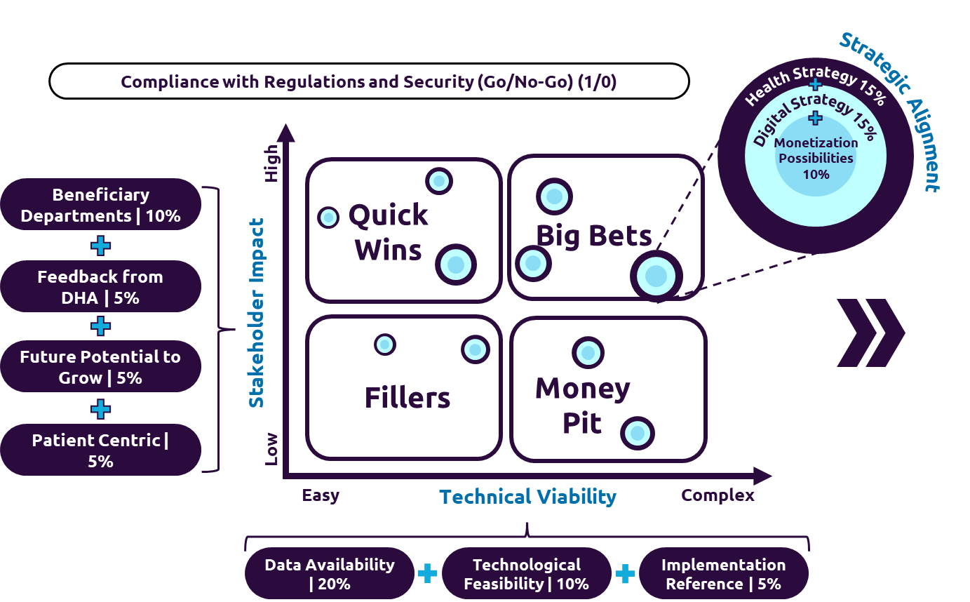
With everything pivoted around our well-proven data
monetization reference architecture point of view
We have crafted an Industry Standard Reference Architecture to implement your data monetization strategy into practice.
People
Process
Technology
Ideation
Qualification
Design
Develop
Publish
Productization
Beneficiaries’ Engagement
PRIORITIZATION FRAMEWORK
Use Case Elaboration
Launch Strategy
Requirements From Departments
KPI Mapping
Delivery Options
Data Publish & Communication
Reports
Dashboards
Data Sharing Contracts
Insights
Raw Data
Market place
Use Case Registry
Proof of Concept (POC) Minium Viable Product ( MVP )
CDC/Data Engineering Pipeline Design
Development : Joins / Extract / BI
Data Analysis & Provisioning
Monitoring and Evaluation
Architectural Design
Subscription Growth, User Engagement, Beneficiaries’ Satisfaction, Revenue and Cost Analysis, Market Penetration
Business Opportunity
Requirements From Industries
Beneficiary Mapping
Use Case Not Qualified For Productization
Regular Data Audits, User Surveys and Feedback Loops, Performance Reviews, Quality Assurance Checks
Pricing Strategy
Freemium, Pay per Usage, Subscription, License etc.
Use Case Factory
Product Factory
Monetization Factory

Slide 16
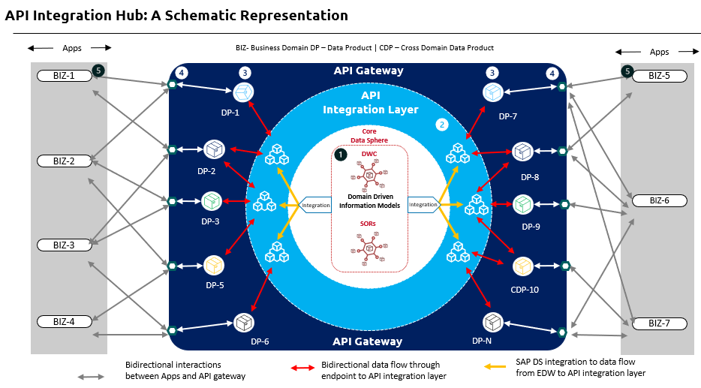
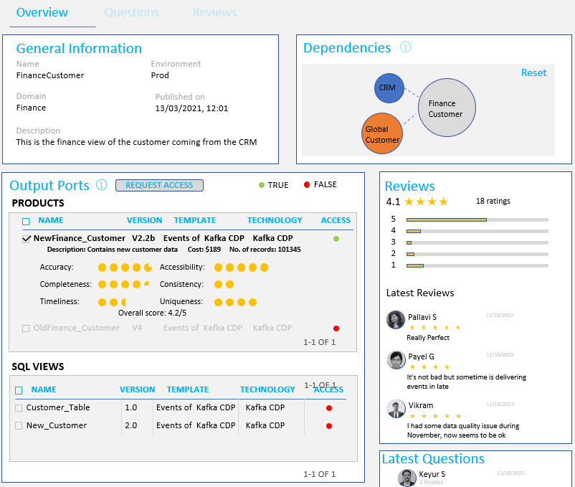
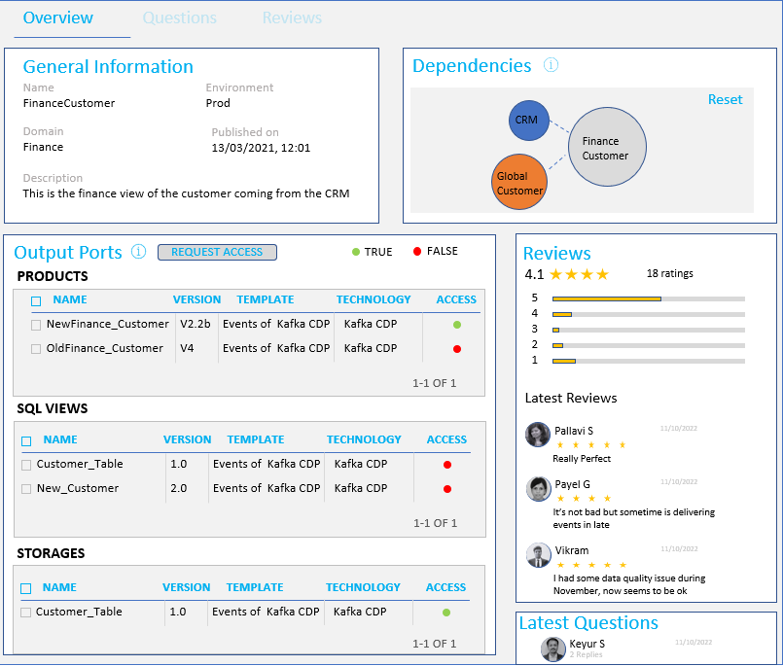
An illustration of data monetization interface mapping with
data marketplace sample
We have implemented proven API led architecture patterns to implement enterprise data marketplace enabling data monetization.
API Integration Hub: A Schematic Representation
Data marketplace in action – Sample Snapshot
API Gateway driven wrapping system on existing architecture to enable templated containerization to enable exchange of data products
Crafted enterprise data marketplace powered by data catalog and data product reviews feature

Slide 17
Our Day 1 team for this engagement
I
Proposed Team Structure
II
Team Profiles

Slide 18
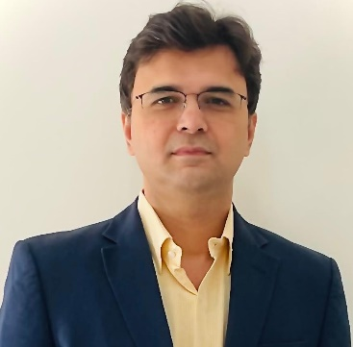
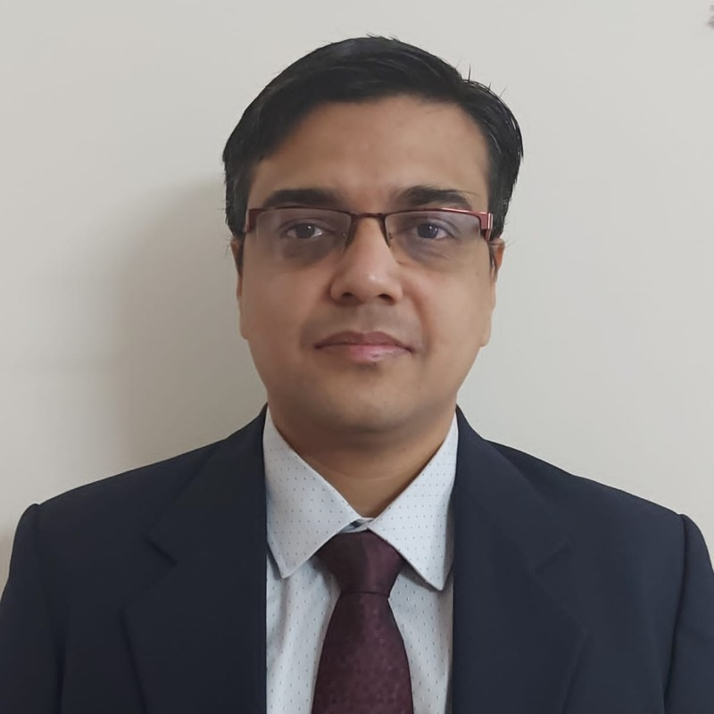
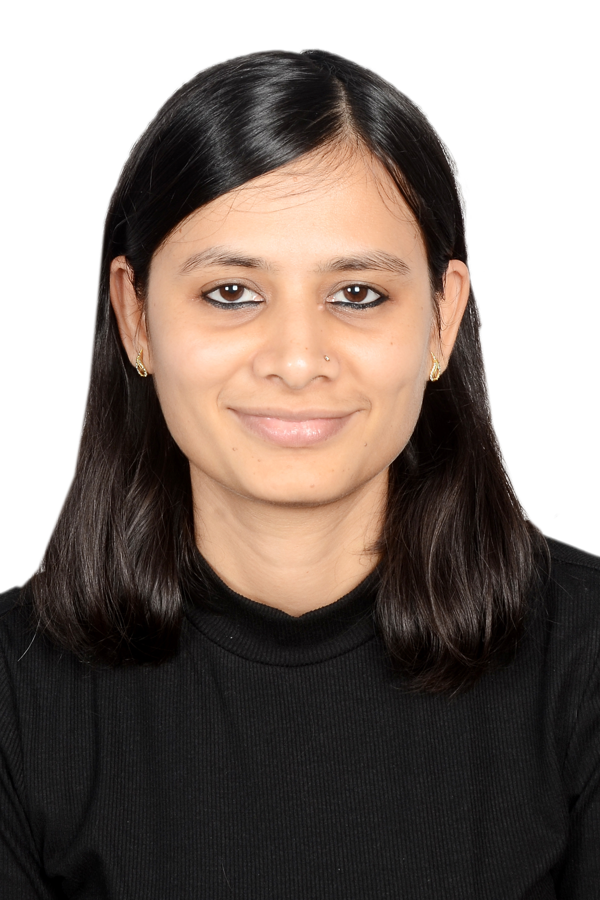

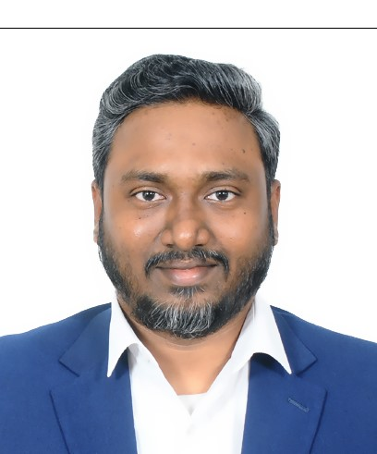
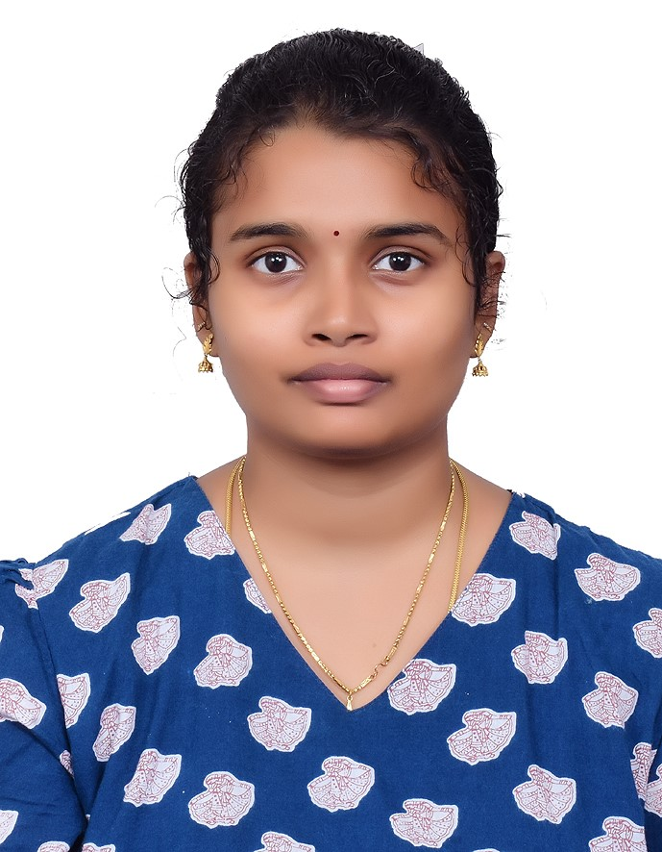
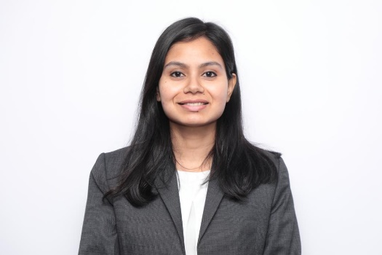
We will mobilize an experienced team comprising of appropriate domain and data credentials for this critical endeavor
Guiding with project's vision, strategy, and execution, and leading the team towards successful project completion.
Amit Joshi
Senior Advisor/
Engagement Accountability
30%
Venkata Sameer
Lead Architect/
Engagement Responsibility
Driving project planning, coordinating and executing project tasks, managing resources, addressing risks and escalations.
100%
Telco Business Consulting Team
Data Consulting Team
Supporting with project execution, assigned tasks, providing expertise, ensuring quality work within deadlines.
Pragya Mishra
Telco Business Consultant
100%
Rohit Singh
Data Strategy Consultant
100%
Rajkamal A
Telco Business Consultant
100%
Saranya Durairaj
Data Analytics Consultant
100%
TEAM PRINCIPLES
Senior team from the start to secure program delivery
Team construct to ensure synergies between Capgemini and Rakuten from Day 1
Collaborative ownership to ensure end to end visibility
Ekta Yadav
Telco Business Consultant
100%

Slide 19
Amit Joshi
Role for this engagement: Senior Advisor
Professional Background
Project Highlights
    Experience of leading Digital & Business Transformation engagements across UK, Europe, ANZ, Nordics & India
    CxO advisory role for leading service providers like Vodafone, BT, Telefonica, Orange, KPN, TDC, Telia etc.
    Worked across domains viz., Digital & Business Transformation, Customer Centricity, IT Strategy formulation, Business Value Enhancement, Digital Process Reimagination
    Comfortable with ambiguity by virtue of leading cross-functional initiatives in matrix organizations
    Six Sigma Black Belt
    Leading UK Telco: Digital Transformation
    Led and delivered multiple work streams in a Digital Transformation program covering Digital Process Reimagination, Product Harmonization for Retail & Enterprise Customers and Systems Rationalization
    Benefits realized for the client included digitization of process across OFAB and Enterprise Management domains, Improved Time to Offer new products/services, enhanced operational efficiency & cost savings via application rationalization
    Leading NL Telco: Digital Process Reimagination
    Led business process transformation advisory engagement
    Customer segments comprised B2C and B2B, domains across Copper, Fiber
    Benefits realized for the client included efficiency gains by virtue of Digital Process Reimagination, FTE redeployment
    Leading UK Telco: Digital Service Design Consulting
    Set up a digital service design consultancy & CoE covering various domains
    Benefits realized for the client included enablement of customer experience improvement across diff service lines via mature service design practices, enablement of new product development opportunities resulting in revenue enhancement
    Leading Norwegian telco: Business Value Enhancement
    Led a strategic advisory engagement to identify and design a Business Objective Value Realization & Enhancement framework for transformation programmes
    Benefits realized included improved organization design, setup of a business transformation KPI mechanism
    Other engagements: Belgian Telco (Business Transformation + Digital RPA), Danish telco (IT Transformation), UK telco (Billing Ops CoE), India telco (shared services setup)
Senior Director
Core Competencies
Telecom Business Strategy
Strategic Program Management
Digital & Business Transformation consulting advisory
Thought Leadership across industry forums
Organizational Business Change Management
Presales/Consultative Selling
Education
Executive Learning: Strategy in Digital Age, IIM Kozhikode
    Executive MBA in Strategy Management from XLRI, India
    Full-Time MBA in Telecom Management from Symbiosis University, Pune, India
    Bachelor of Engineering in Electronics & Power, Nagpur
    Diploma in Digital Strategies for Business

Slide 20
Venkata Sameer
Role for this engagement: Lead Architect
Professional Background
Project Highlights
    Experienced in Technology Consulting, Solution Design, Architecture Recommendation, Presales Consulting, Product Delivery, and Customer Engagement.
    Expertise on varied areas of telecom space focusing on Next-Gen connectivity - 5G Network Slicing, Multi- Access Edge Computing, 5G/6G Business Use-Case Consulting, Mobile / Fixed line Architecture consulting, Cloud & Containerized Applications.
    Solution Architect | 5G, NFVI & Digital BSS | Leading SEA based Telco
    Architected end-to-end solutions for 5G use cases (eMBB, mMTC, URLLC) and NFVI, defining functional components, network protocols, and interfaces.
    Delivered Ericsson Cloud and Container solutions for 5G network slicing, including Cloud Execution Environment (CEE) and Cloud Native Infrastructure.
    Led Digital BSS solution design for greenfield, brownfield, migration, and capacity expansion projects, driving digital transformation initiatives.
    Provided technical consultation on converged billing, charging, policy management, service lifecycle, and VAS platform adaptations.
    Delivered BSS & Telco Cloud solutions by harvesting best practices, developed reusable artifacts, and introduced automation to optimize OPEX and enhance delivery efficiency.
    Cloud Consultant | Digital Transformation | Leading KSA based Telco
    Provided advisory on digital transformation, GTM strategy, operating model governance, cloud migration, and telecom asset LCM.
    Led BCP readiness assessments, identifying critical gaps and driving budget allocation for risk mitigation.
    Developed business cases, TCO models, and conducted commercial and operational due diligence for telecom clients.
    Built expertise in 5G, Telco Cloud, next-gen connectivity, data center solutions, and broadband/optical fiber rollout.
    Acted as SME for IT infrastructure assessments, delivering modernization roadmaps for Middle East government clients.
    Technology Consultant | Telecom Enterprise Solutions | Leading UAE based Telco
    Developed IP assets for 5G cloud TCO modeling and vendor landscape analysis.
    Led cloud cost optimization initiatives, identifying INR 100Mn+ savings for client.
    Contributed to digital transformation frameworks for high-tech and semiconductor sectors.
    Delivered strategic insights on enterprise architecture and operating model enhancements.
Solution Architect
Core Competencies
Education
Filed 7 Patents For Ericsson in AI/ML, predictive analytics and IOT
Process Design & Optimization
OSS/BSS Transformation
Technology Consulting
Solution Design
Architecture Recommendation
Product Delivery
Customer Engagement
Stakeholder Management
    SITM (Symbiosis), MBA, Telecommunications Management
    Guru Gobind Singh Indraprastha University, B.Tech. Information Systems
Certification
    Business Process Framework (eTOM) Fundamentals - TMForum
    ITIL V4 Foundation
    Application Framework (TAM)
    Ericsson Charging & Billing in One (Associate)
    Ericsson Mobile Broadband Charging (Associate)

Slide 21
Pragya Mishra
Role for this engagement: Telco Business Consultant
Professional Background
Project Highlights
    Experienced in Program Management and Consulting, working with global Telecom and IT clients.
    Expertise in Business Process Optimization, Digital Transformation, Project Management, and Stakeholder Engagement.
    Skilled in Operating model development, process improvement, strategic planning, partner governance, and leveraging data analytics to drive business efficiency and growth.
    Business Consultant | IMF Revamp | Leading KSA based Telco
    Developed an innovative framework to optimize the Item Master File (IMF) for a telecommunications provider, enabling efficient tracking of procured items
    Developed operating model and established master data governance through the centralized team to enforce compliance and perform regular reviews of Item Master File (IMF).
    Business Consultant | GTM Strategy | SIM manufacturer in Europe
    Conducted a comprehensive market assessment, analyzing critical trends and emerging opportunities to enable strategic decision-making.
    Formulated a robust go-to-market strategy for establishing operations within the Indian IoT logistics sector.
    Business Consultant | Unified Inspection Framework | Government entity in Middle East
    Developed a Unified Inspection Framework streamlining the inspection process through an optimized operating model and regulatory checklist.
    Risk Consultant | Internal Audit | Telecom Service Providers in Middle East
    Evaluated campaign management effectiveness, identifying gaps in governance, reporting, and compliance, and proposing corrective actions.
    Optimized the Product Development Lifecycle by integrating systems, automating processes, and establishing SLAs.
    Led teams in executing audit fieldwork, analyzing data, facilitating discussions on risk mitigation strategies and operational enhancements.
    Technical Project Manager | Leading India based Telco
    Led automation project as a Technical Project Manager, enabling two-way communication via Rich Communication Services (RCS) and WhatsApp, significantly boosting digital engagement.
    Managed SDLC and coordinated with stakeholders, vendors, and cross-functional teams to ensure timely delivery of digital projects.
    Implemented key projects like Amazon Prime Youth Offer integration and mPower (Sales App) enhancements, improving customer experience and operational efficiency.
Senior Manager
Core Competencies
Education
Business Process Optimization
Digital Transformation Strategies
Operating Model Development
Market Entry Strategies
Customer Value Management
Program Management Excellence
Operational Efficiency Improvement
Stakeholder Engagement Techniques
Partner Governance & Management
    MBA in Telecom Management from Symbiosis International University, Pune
    BE in Electronics & Communication from SJCIT, Bangalore
Certification
    Microsoft Visio & PowerBI
    Adobe Analytics, Target & Audience Manager
    Omnibug
    Google Developer

Slide 22
Rajkamal A
Role for this engagement: Telco Business Consultant
Professional Background
Project Highlights
    Seasoned Professional with experience specializing in telecom deployment, digital transformation, management consulting and project management.
    Expert in orchestrating workshops, crafting efficient business processes, and overseeing complex IT infrastructure projects.
    Business Analyst | B2C BSS Digital Transformation | Leading KSA based Telco
    Analyze product consumption data to rationalize product portfolio and offer propose personalized offerings product specifications for different customer segments
    Discovered As-Is C2M & O2C processes and user journeys through workshops with stakeholders (onsite and offsite)
    Facilitated process redesign, serving as a liaison to the business community while advising on all change aspects
    Business Process Architect | Greenfield 5G Deployment | Leading German MVNO
    Organized workshops with various stakeholders to ensure a complete understanding of process requirements
    Created process blueprints and user stories to drive application requirements and metrics
    Designed B2B business processes (L2 & L3) for RAN site (Passive & Active) deployment, Transport and Core Network deployment, service delivery platform implementation such as IMS and network operations, including RACI and KPIs
    Product Owner | Greenfield NGIL Implementation | Leading UAE Telco
    Prioritized the development stories based on priorities defined for greenfield user stories in the product team workshops
    Driven the sprint planning sessions and agreed the content of the sprints (Sprint Backlog) with the Scrum Team
    Ensured sprint delivery is in line with the sprint plan and shared the required sprint reports with the project stakeholders
    Project Manager | IT Infrastructure Implementation | Enterprise Clients
    Responsible for delivering complex, multi-technology, IT Infrastructure Projects/Program for Enterprise, Telecom, BFSI, IT/ITES, Media Clients
    Delivered 40+ Projects End to End on various Technology Domains such as Networking, Data Centre Networking, Cybersecurity, Collaboration and End User Computing
Education
Manager
Core Competencies
    SITM (Symbiosis), MBA, Telecommunications Management
    SIET (Anna University), B.Tech. Information Technology
Business Consulting in Telecommunications domain
Product Management
Business Process Management
Process Design & Optimization
OSS/BSS Transformation
Stakeholder Management
Project and Program Management
Agile Project Management
Certification
    Business Process Framework (eTOM) Fundamentals - TMForum
    ITIL V4 Foundation
    PRINCE2 Foundation and Practitioner
    PSM I - Professional Scrum Master
    Microsoft Azure Fundamentals AZ900
    AWS Cloud Practitioner & Solution Architect
    ISO 22301:2012

Slide 23
Ekta Yadav
Role for this engagement: Telco Business Consultant
Professional Background
Project Highlights
    Experienced in the Telecom & IT industry, collaborating with major global Telecom clients on Digital Transformation, Product and Project Management, Business Process Design and Improvement, Business analysis and Requirements elicitation.
    Skilled in Agile Product Management, Functional and Technical business analysis, Project governance, Stakeholder management, user story creation, and Process consulting
    Data Analysis | Opex – Capex spending Analysis of leading telcos in North American
    Gathered and analyzed Operating and capital expenditure data of 3 major telcos in USA
    Created financial insights on spent components as per industry standards and best practices
Project Management | Data Migration to Azure Cloud | Distribution Company, UAE
    Spearheaded pivotal activities in a cloud data migration to Data lakes including formulating detailed phase wise project plan, conducting readiness assessments, disseminating weekly progress report for senior leadership, meticulously managing RAG and proactively engaging key stakeholders to remove RAID
    Technical Business Analyst | Data-centric approach to Fiber expansion| Leading UK Telco
    Gathered business requirements, translated them into functional & technical requirements
    Analyzed Construction contracts, created 40+ reports to cater to various governance forums
    Business Analyst | B2b O2C Digital Transformation | Leading KSA based Telco
    Coordinated design thinking workshops sessions with Business teams for requirement elicitation and created the Functional Requirement Specifications document (FRS) for the “new To be state” O2C journey
    Product Management| Business Experience Transformation | US based Telco
    Overseeing all the experience transformation initiatives of fulfillment 20+ products portfolio by closing working with business and Development stakeholders as well as vendors
    Business Analyst | Future Talent Strategy| Japan based Telco
    Designed high level business capability model, analyzed telco trends created future-proof talent strategy, through in-depth primary & secondary research & industry trend analysis & generated long-term actionable recommendations
    Process Consultant | Broadband products on Fiber | Sony Networks, USA
    Designed business processes for e2e Order to Cash (O2C), Billing and Service Assurance
    Crafted Application workflow based on data flow in BSS systems which were involved in entire customer journey, ranging from Lead stage to order fulfillment and payment closure
    Analyzed 200+ user stories, identified gaps in process flows and enriched processes to meet product launch readiness
Manager
Core Competencies
Education
Business Consulting in Telecommunications domain
Product Management
Business Process Management
Process Design & Optimization
OSS/BSS Transformation
Stakeholder Management
Project and Program Management
Agile Project Management
MBA from IIM, Bangalore
BTech from IIT Roorkee
Certification
Certified Scrum Product Owner (CSPO)
Business Process Framework (eTOM) Fundamentals
AI for everyone (DeepLearning.AI)

Slide 24
Rohit Singh
Role for this engagement: Data Strategy Consultant
Professional Background
Project Highlights
    Experienced in areas such as Data Management and Strategy, Digital Transformation, Product Management and Business Analysis. Also, adept at working with global cross-functional teams and handling end to end SDLC.
    Proven expertise in industries such as Healthcare, BFSI and Media and Entertainment
    Skills: Management Consulting, Data and Analytics Consulting, Product Management, Market Research, Business Development, Thought
    Data Management, Strategy and Governance | Major American publishing firm
    Perform Data Ecosystem Audit and designed its Data Strategy to identify and prioritize opportunities to enhance - Data Science activities and Data Governance.
    Collaborated with client’s Clinical R&D Director and assisted him in Data Classification, Data Cataloguing and Data Mastering activities to ultimately conduct a mock Data Audit to validate regulatory adherence.
    Designed a Value from Data framework taking Business Value and Implementation Complexity parameters into account to prioritize clients’ Data and Analytics use cases, thus providing an asset-based approach to consulting
    Developed a Data Maturity Assessment Toolkit to quantify the AS-IS state of data assets and capabilities of an organization and benchmark it against industry standards.
    Liaised with business users to gather 500+ requirements, create wireframes, and define user and system specifications for a pharma application used for early detection of drug manufacturing process deviations.
    Developed ITIL compliant ITSM assessment framework and conducted interviews with our Banking client’s stakeholders to review its ITSM processes and benchmarked the performance against industry best practices.
    Product Engineering (Oracle)
    Played a key role in shaping the product roadmap through in-depth competitor analysis to ensure market relevance. Led client workshops to drive collaboration, resulting in increased product adoption and engagement.
    Empathized with customers and developed customer service strategies, that helped reduce their debug time by 20% thereby improving customer experience.
    Engineered and managed a validation framework using REST APIs in Oracle cloud (Storage as a Service) to check the veracity of our product that helped in eradicating data integrity issues.
    Created automated periodic alerting mechanism, reducing manual efforts and operational costs by 30%
    Unearthed critical data encryption-security issue pre-existing in our product by deep diving into seemingly innocuous product messages
Manager
Core Competencies
Data Strategy
Data Management
Data Governance
Product Management
Business Analysis
Market Research
Thought Leadership
Project Management
Education
    MBA (General Management) from Indian Institute of Management, Calcutta
    B.Tech (Information Technology) from Birla Institute of Technology, Mesra
Tools & Technology:
ORACLE RDBMS, MYSQL, DATABRICKS, IBM SPSS MODELLER, DCAM, DAMA, OCI, PYTHON, POWER BI , SNOW, SALESFORCE

Slide 25
Saranya Durairaj
Role for this engagement: Data Analytics Consultant
Professional Background
Project Highlights
    Experienced in Analysis, Development, Administration of BI applications in Qlik and Power BI
    Defining and tracking Sales and Purchase KPIs
    Transposing complex business requirements into dashboards, managing ETL processes and customizing reports to meet specific business needs
    Developed wireframe and Proof of Concepts(POC) for various projects
    Responsible for creating detailed technical specification, user requirements and unit test report documents
    Online store analysis (Power BI, SQL)
    Collaborated with business users to define and prioritize dashboard objectives
    Gathered requirements and designed data models to support multi-dimensional analysis
    Created and optimized SQL queries using joins, functions, and set operators for data extraction
    Developed interactive reports and visualizations in Power BI, utilizing calculated columns, measures, and bookmarks
    Optimized dashboards for performance and responsiveness
    Conducted user training and provided documentation for effective dashboard usage
    Monitored, maintained, and updated dashboards based on client feedback and evolving business needs
    Sales Domain (Power BI, Excel) ​
    Collaborated with the client to define project scope and key metrics
    Created wireframes for UI/UX approval
    Analyzed and transformed source data using Power BI and Power Query
    Designed and developed an interactive dashboard with DAX functions, slicers, buttons, and bookmarks
    Optimized UI for seamless navigation, ensuring alignment with client expectations
    Delivered the final dashboard with documentation and provided ongoing support for updates and maintenance
    Qlik Cloud Administration (Qlik SaaS)
    Involved in Admin activities like Data Gateway Installation, Data connector configuration, monitoring apps upgradation, space creation and resource allocation to various users
    Ensuring app size threshold, license allocation, data reloads and platform availability through monitoring apps
    Worked under Production support to perform data connection failure issues, license de-allocation for inactive users &licenses renewal for 3rd party vendor extensions
Senior Consultant
Core Competencies
Business Intelligence Tools – Power BI, Qlik Sense, QlikView
Distribution Tool – NPrinting
RDBMS – SQL Server
Education
    Bachelor of Engineering – CSE from M.A.M college of Engineering and Technology (Affiliated by Anna University, Chennai)

Slide 26
As your Strategic Partner, we are ready to work closely with you to help realize end to end value realization
Having presented the delivery model and outlined the potential resource plan, we are committed to collaborate with you and are fully prepared to commence the engagement at the earliest opportunity.
We recommend to deliver this consulting engagement via a Time & Material contract, to address the evolving nature of deliverables and to be able to realize the full intensity of working alongside your teams in a One Rakuten – One Capgemini engagement model.
Following are the applicable rates as per roles outlined previously:-
We look forward to aligning on next steps and beginning this partnership with momentum and clarity.
Role | Capgemini rate (per day) for Rakuten Mobile
Senior Advisor
Engagement Manager
Telco Business Consultant
Data Strategy Consultant
Data Consultant

Slide 27

About Capgemini Invent
As the digital innovation, design and transformation brand of the Capgemini Group, Capgemini Invent enables CxOs to envision and shape the future of their businesses. Located in more than 36 offices and 37 creative studios around the world, it comprises a 10,000+ strong team of strategists, data scientists, product and experience designers, brand experts and technologists who develop new digital services, products, experiences and business models for sustainable growth.
Capgemini Invent is an integral part of Capgemini, a global leader in partnering with companies to transform and manage their business by harnessing the power of technology. The Group is guided everyday by its purpose of unleashing human energy through technology for an inclusive and sustainable future. It is a responsible and diverse organization of over 360,000 team members in more than 50 countries. With its strong 55-year heritage and deep industry expertise, Capgemini is trusted by its clients to address the entire breadth of their business needs, from strategy and design to operations, fueled by the fast evolving and innovative world of cloud, data, AI, connectivity, software, digital engineering and platforms. The Group reported in 2022 global revenues of €22 billion.
Get The Future You Want | www.capgemini.com

